Slide 1
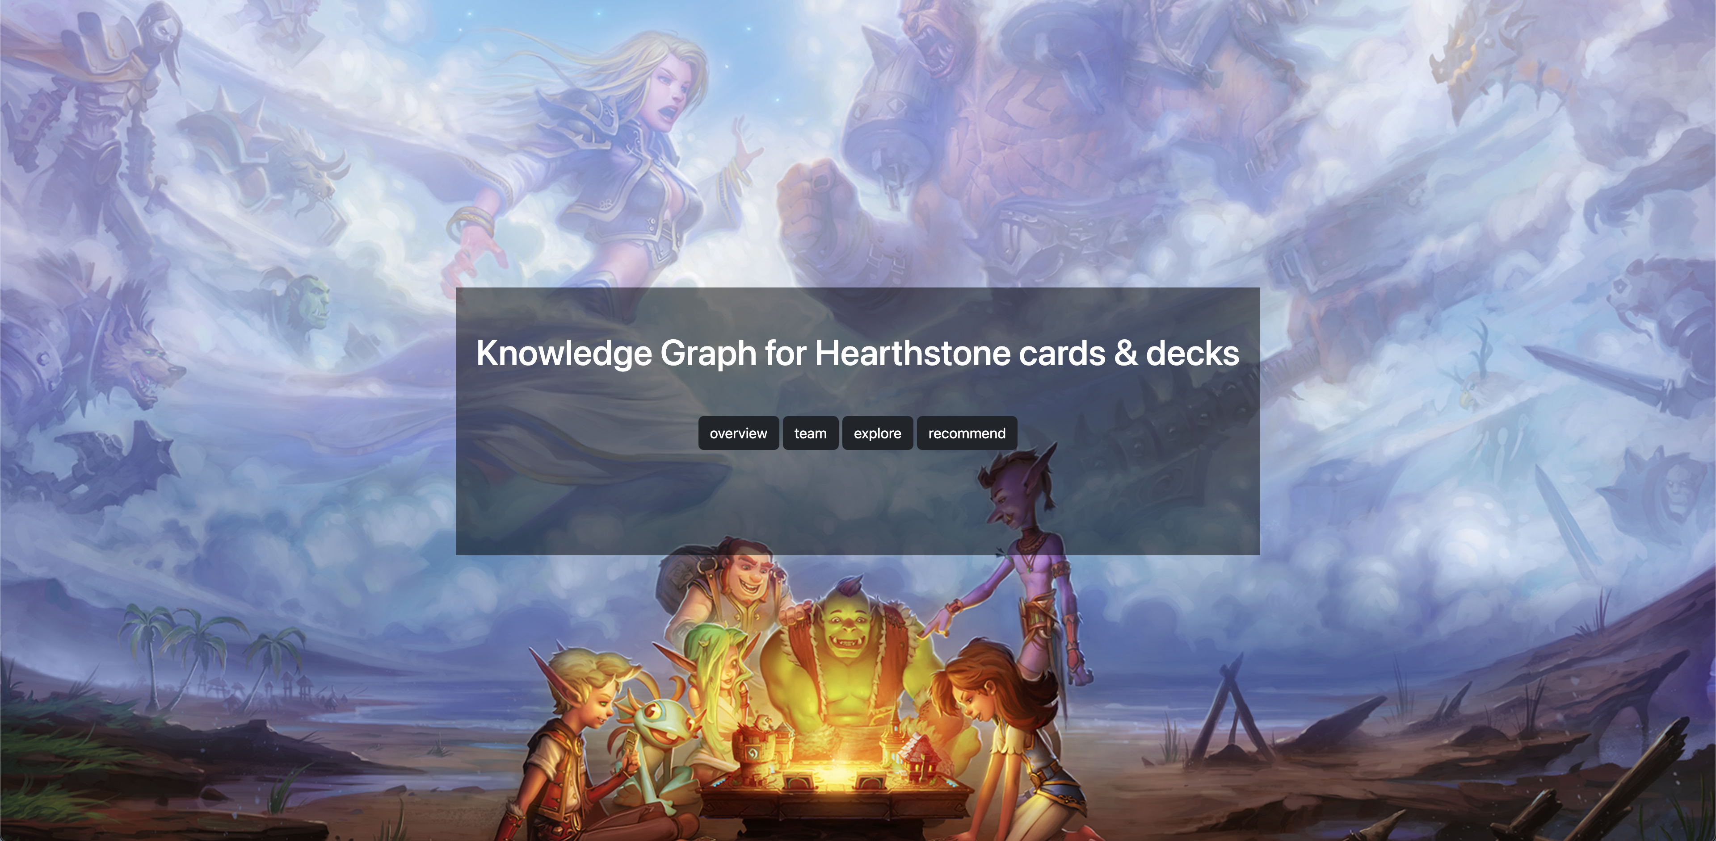
Building Knowledge Graph for Hearthstone cards & decks
Xuyang Wang, Yuqin Chen

Slide 2
Contents
Goal / Objective
Data Processing
Data Source
Data Extraction(Crawler)
Technical Challenge1: Big data volume
Functionality
System Architechture
Technical Challenge2: Explore Card & Deck
Sparql Example
Technical Challenge3: Recommender System
Evaluation
KG Quality
UI Design

Slide 3
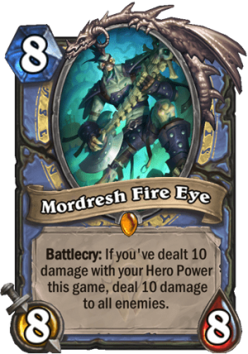
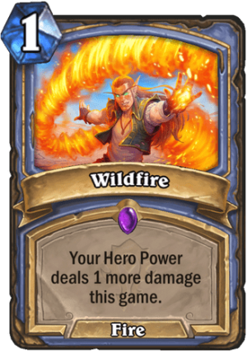
Goal / Objective
Building a knowledge graph about Hearthstone cards & decks - Players can explore relationship between cards & decks based on KG - Recommend related cards for player
SECRET MAGE
(a deck)
MORDRESH FIRE EYE
(a card)
Battlecry: If you've dealt 10 damage with your Hero Power this game, deal 10 damage to all enemis.
Mana Cost: 8
Attack: 8
Health: 8
Rarity: Legendary
Class: Mage
Type: Minion
Set: Forged in the Barrens
Mechanics: Battlecry, Damage All
…
MORDRESH FIRE EYE
(a card)
Battlecry: If you've dealt 10 damage with your Hero Power this game, deal 10 damage to all enemis.
Mana Cost: 8
Attack: 8
Health: 8
Rarity: Legendary
Class: Mage
Type: Minion
Set: Forged in the Barrens
Mechanics: Battlecry, Damage All
MORDRESH FIRE EYE
(a card)
Battlecry: If you've dealt 10 damage with your Hero Power this game, deal 10 damage to all enemis.
Mana Cost: 8
Attack: 8
Health: 8
Rarity: Legendary
Class: Mage
Type: Minion
Set: Forged in the Barrens
Mechanics: Battlecry, Damage All
MORDRESH FIRE EYE
(a card)
Battlecry: If you've dealt 10 damage with your Hero Power this game, deal 10 damage to all enemis.
Mana Cost: 8
Attack: 8
Health: 8
Rarity: Legendary
Class: Mage
Type: Minion
Set: Forged in the Barrens
Mechanics: Battlecry, Damage All
Wildfile
(a card)
Mana Cost: 1
Rarity: Epic
Class: Mage
Type: Spell
Set: Forged in the Barrens
Wildfile
(a card)
Mana Cost: 1
Rarity: Epic
Class: Mage
Type: Spell
Set: Forged in the Barrens
Wildfile
(a card)
Mana Cost: 1
Rarity: Epic
Class: Mage
Type: Spell
Set: Forged in the Barrens
Wildfile
(a card)
Mana Cost: 1
Rarity: Epic
Class: Mage
Type: Spell
Set: Forged in the Barrens
Wildfile
(a card)
Mana Cost: 1
Rarity: Epic
Class: Mage
Type: Spell
Set: Forged in the Barrens
Wildfile
(a card)
Mana Cost: 1
Rarity: Epic
Class: Mage
Type: Spell
Set: Forged in the Barrens

Slide 4
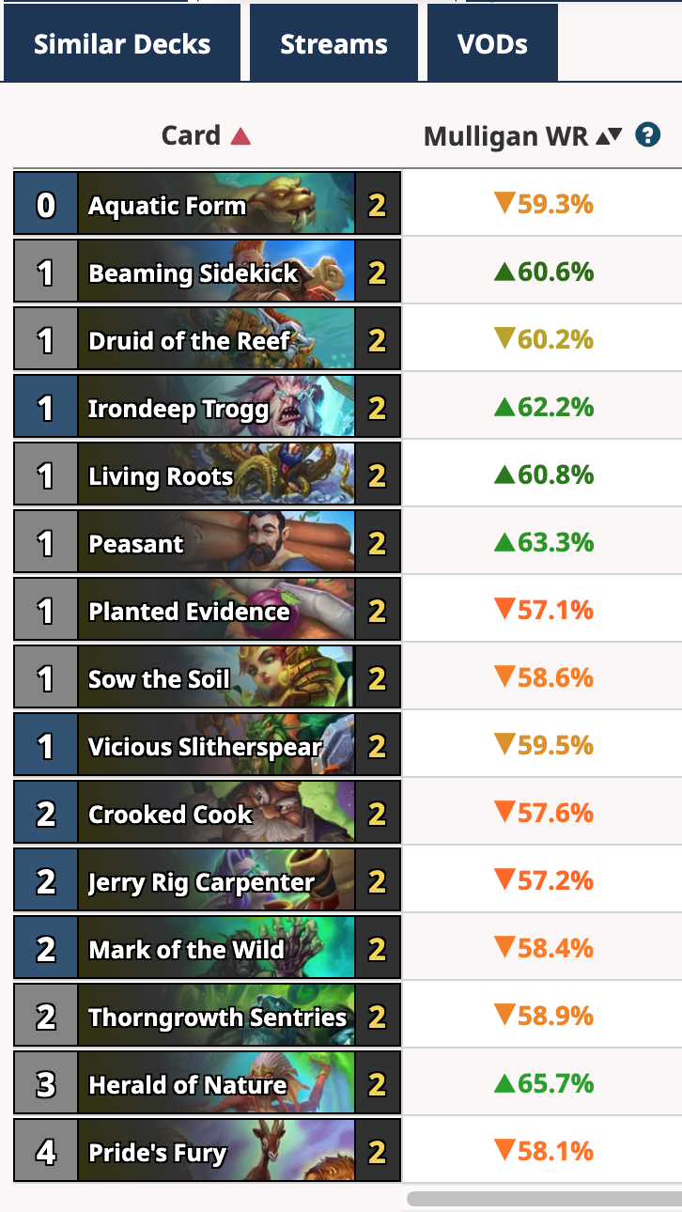
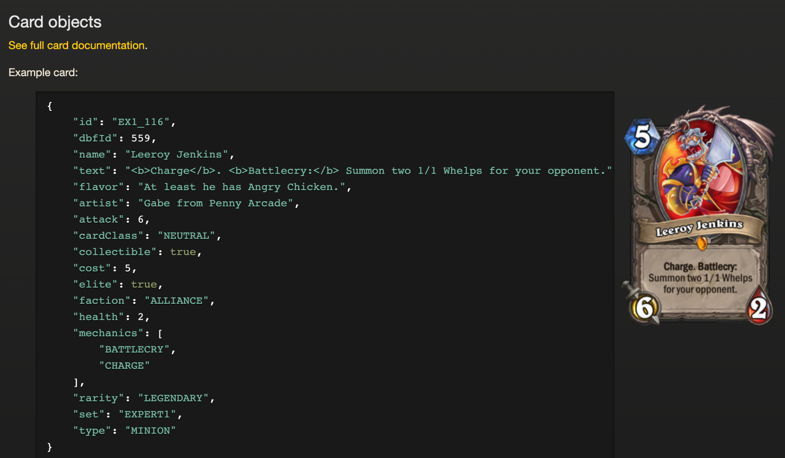
Data Source
Decks:
https://hsreplay.net/decks/ Decks: https://www.hearthstonetopdecks.com/
HearthstoneJSON
https://hearthstone.blizzard.com/en-us/cards

Slide 5
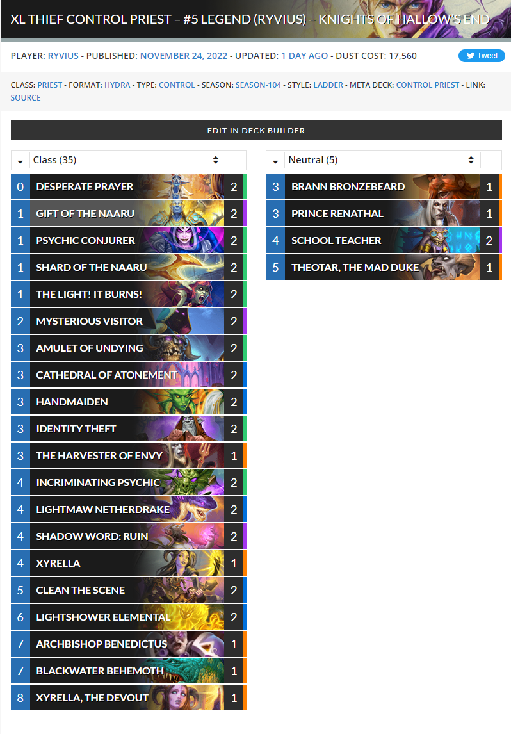
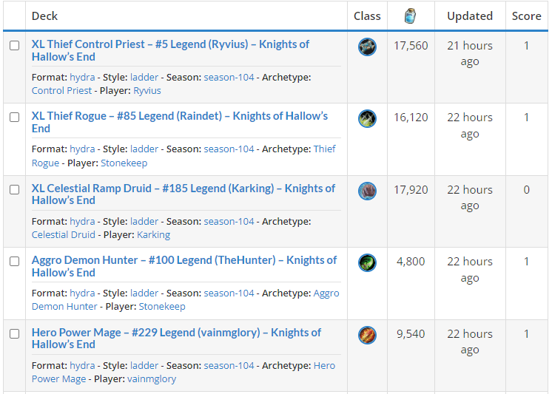
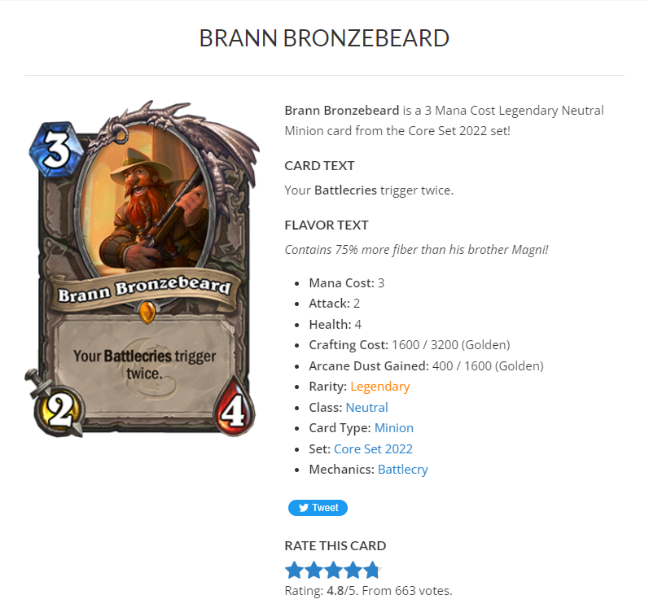
Data extraction -- How crawler works?
https://www.hearthstonetopdecks.com/decks/xl-thief-control-priest-5-legend-ryvius-knights-of-hallows-end/
https://www.hearthstonetopdecks.com/decks/
https://www.hearthstonetopdecks.com/cards/brann-bronzebeard/

Slide 6
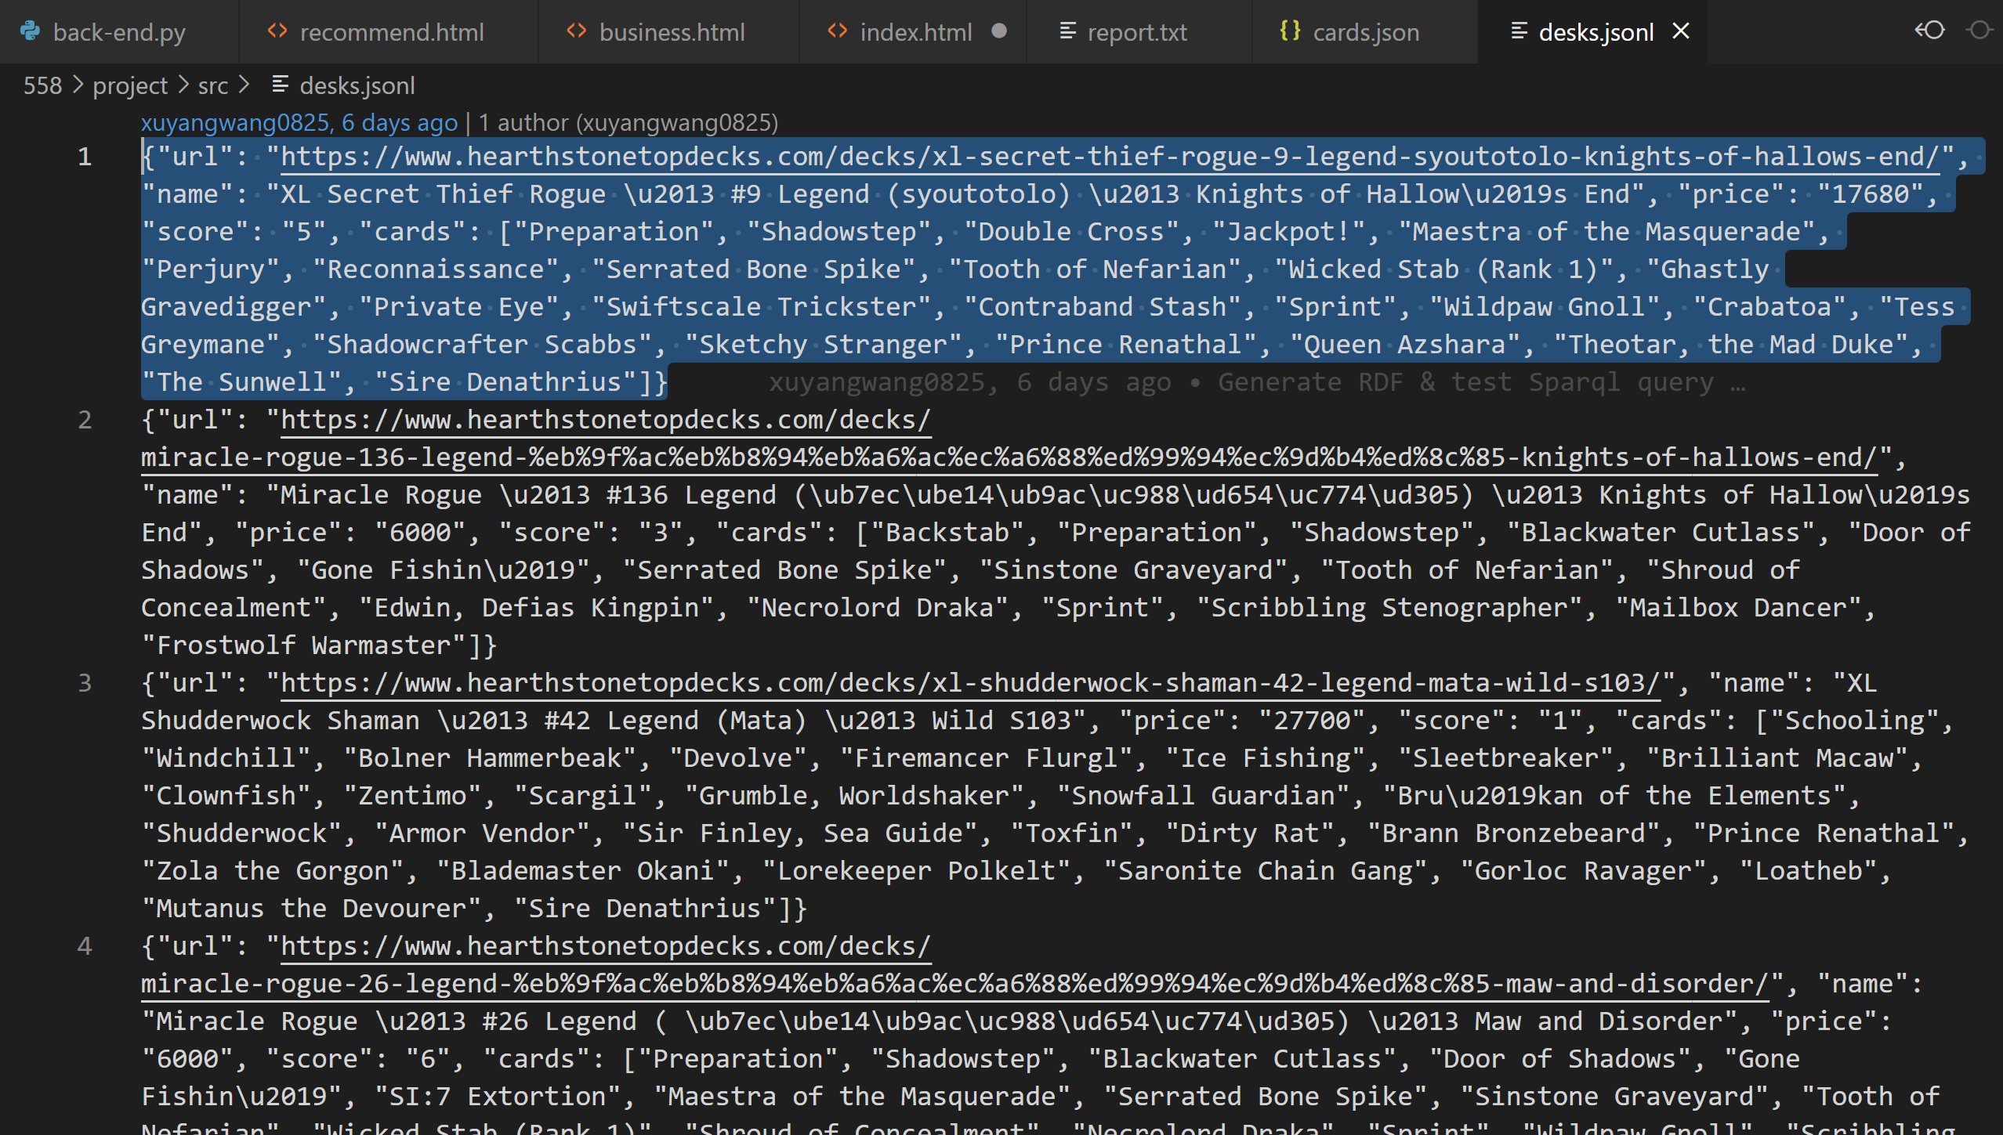
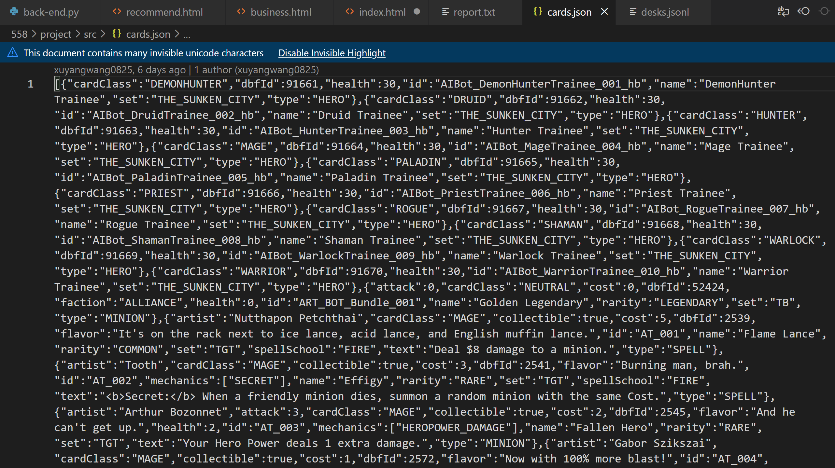
Data extraction -- How crawler store data? store data in two json files, then those files will be used for ontology build.
scrapy deck1
write deck1 to json
scrapy deck1:card1
write card1 to json
scrapy deck1:card2
write card2 to json

Slide 7
Data extraction -- Data volumn
each page contains about 20 decks
each deck contains about 20 cards
100 pages of newest decks shared by players
So, 100*20*20 = 40,000 !

Slide 8
Technical Challenge1: Big data volume
Problem: How to get so many data without damaging the server or be banned by the server?
Solution: Set a delay between every two requests.
Evaluation:
- request one or two times per second is just like a normal human action, so not damage the server;
- succesfully got all data without any restriction or ban by the website after the program ran several hours.
- also, randomly selected several decks to check if their information is correct in the json file.

Slide 9
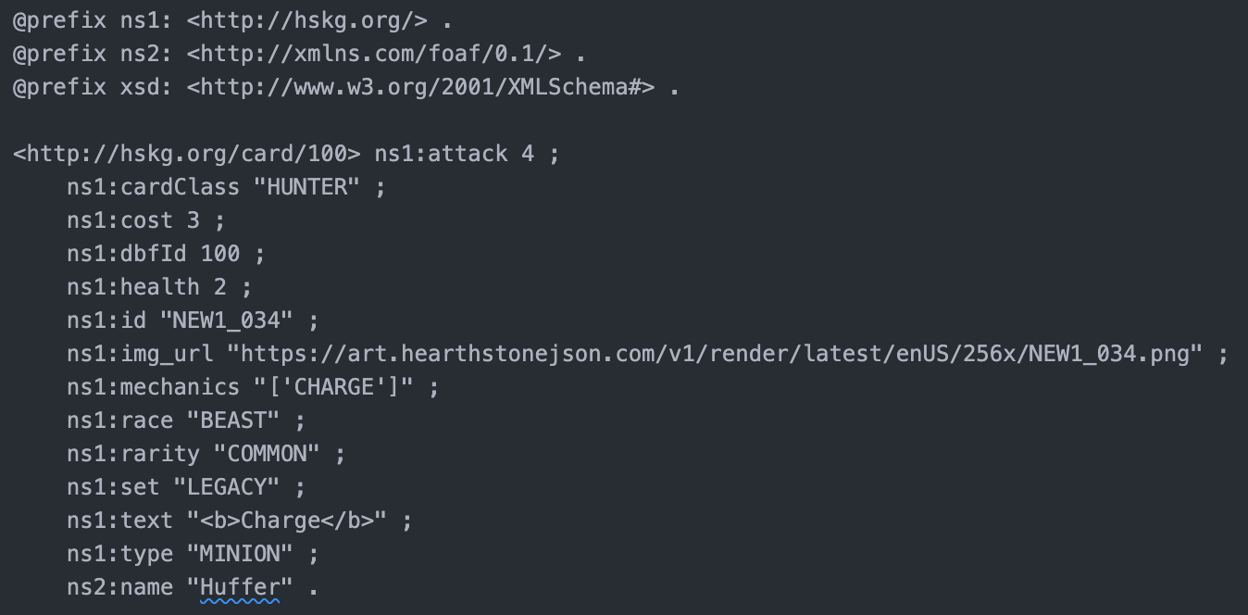
Ontology
Card:

Slide 10
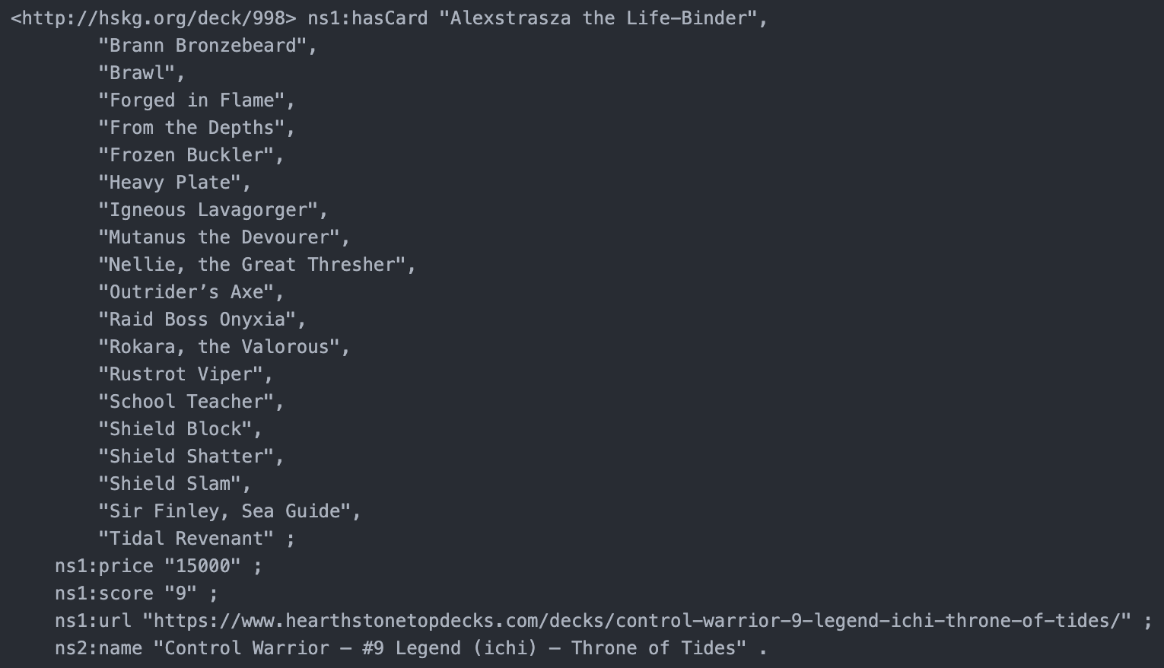
Ontology
Deck:

Slide 11







System Architechture
Card & Deck KG
Embedding and training
Recommend cards
Unstructured Data

Slide 12
Technical Challenge2: Explore Card & Deck
Problem: How to give player a easy way to explore the card they want?
Example: A player want to find a replacement of a card in mage class and cost 7+.
Solution:
- Build KG for cards
- Use sparql to search and filter the entitys
- Return result as a graph to help player find the card they want.
Evaluation:
- That’s very precise. Player can modify the parameter of filter to get the result space as a graph.

Slide 13
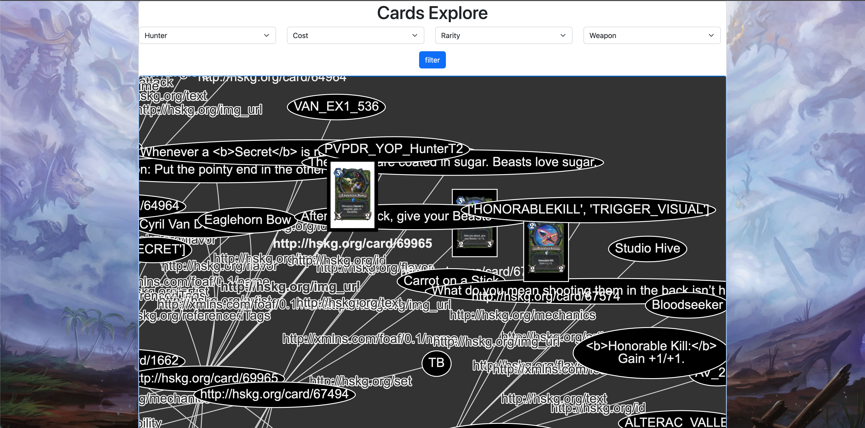
Explore Card
Parameters:
Class : [Mage, Hunter…] 12classes
Cost: [0～6, 7+]
Rarity: [Free, Common, Rare, Epic, Legendary]
Type: [Minion, Weapon, Spell…] 7 types

Slide 14
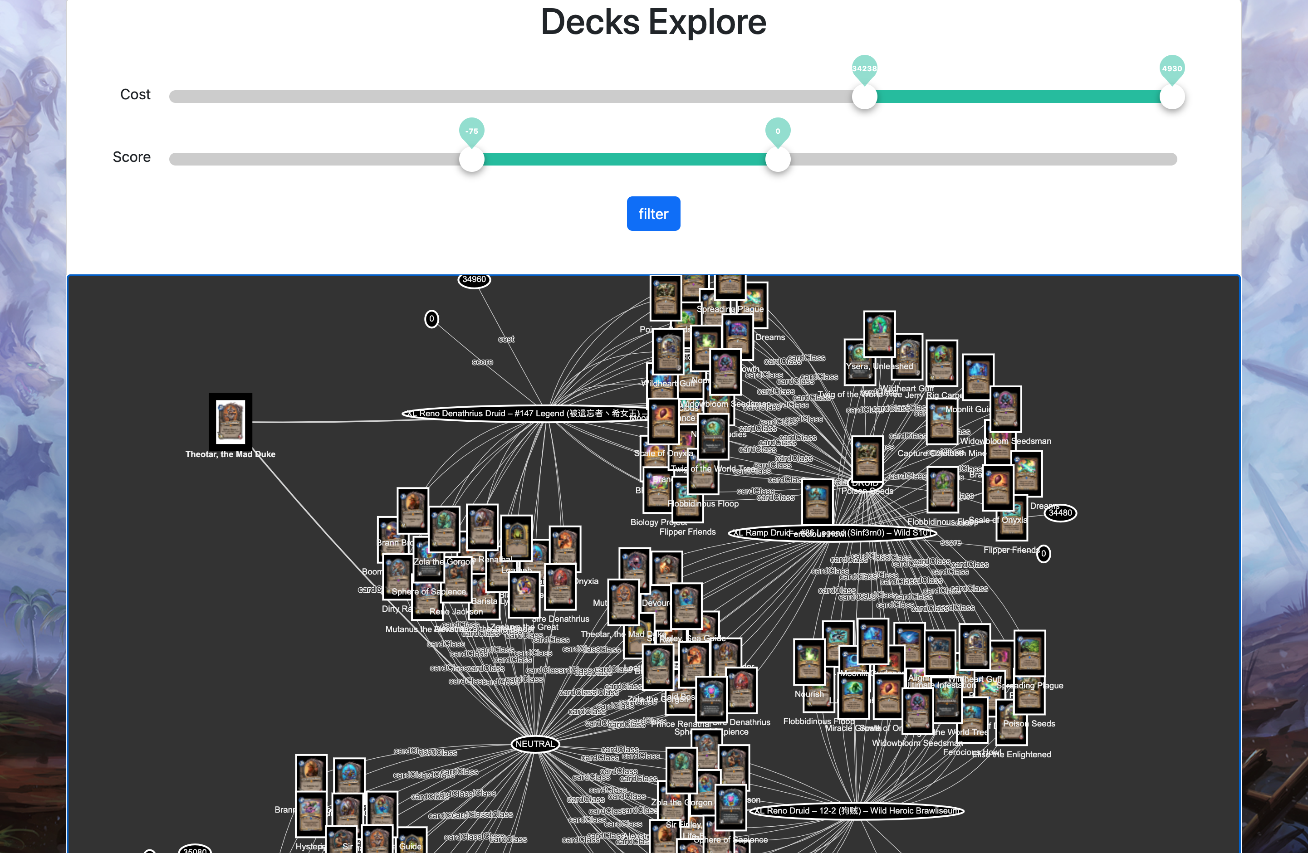
Explore Deck
Parameters:
Score: [-150, 150]
Cost: [0~50000] Arcane Dust

Slide 15
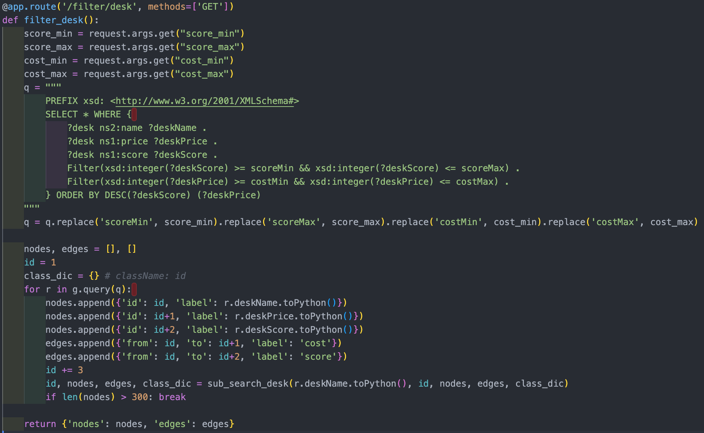
Sparql Example - Deck
Call API in front-end
Back-end get parameters:
Score & Cost
Sparql query
Generate Graph
Use Vis.JS
Generate nodes
Generate ndges
Return result
Show graph in front-end

Slide 16
Technical Challenge3: Recommender System
Problem: How to recommend more cards for a existing deck?
Solution: Build a TransE model. (More details in report)
Evaluation: Randomly hide 20% data in the triples (deck-hasCard->card) as test dataset, got a 0.09 MRR.

Slide 17
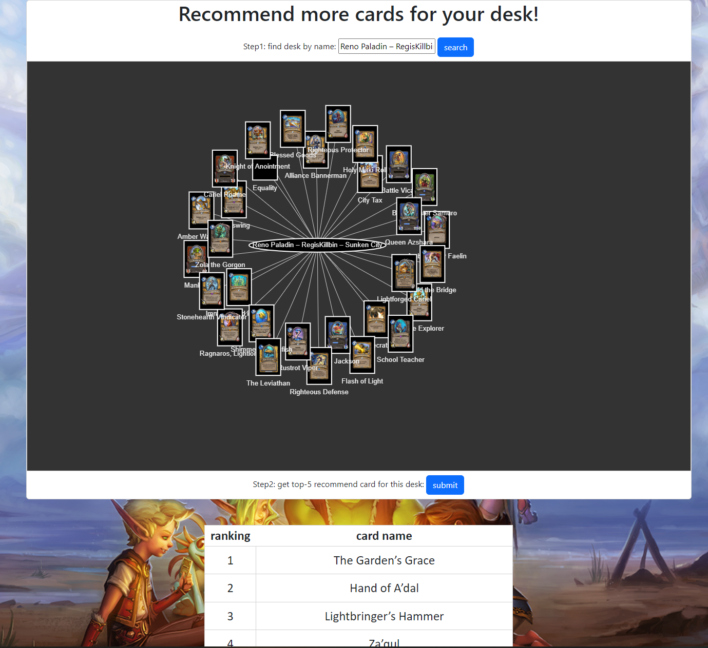
Recommend card for a deck

Slide 18
KG Quality
Intrinsic
Accuracy: All cards and decks free of error & correctly describing facts
Objectivity: Decks are from different players, so it’s free of bias & impartial. Cards’ information are official.
Consistency: Card’s properties and deck’s properties are consistent.
Contextual
Card data is up to date
Deck data is required to update periodically by crawler
Representational
Data can be interpreted by machine and human without ambiguity

Slide 19
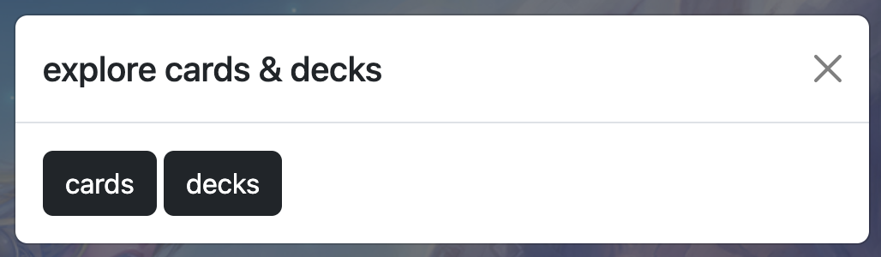
UI Design
Overviw:
Introduction of our system
Team:
Introduction of team members
Explore
Explore card & deck
Recommend
Recommend card based on deck
Home Page

Slide 20
Future works
support users upload their own decks;
get more data to better train the model:
more accuracy score of each decks in KG
more attributes of each decks like the win-lose rate
expand the KG with competition data
more data visualizations to better analyze data

